Slide 1
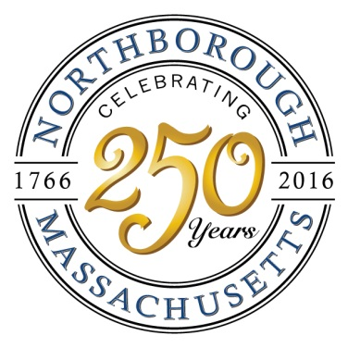
NORTHBOROUGH'S 250th FINALE DINNER DANCE
1766-2016
DRESS in your favorite fashion from 1766 – 2016!
October 29, 2016
Cocktail Hour 7:00, followed by Buffet Dinner
Dance to the music of the exciting 8-piece band, "SPLASH"
7:00pm-12:30am
Double Tree by Hilton Westborough
5400 Computer Dr., Westborough, MA 01581
Cost: $50.00 per person
Open seating of 10 per table
Seating is limited, so purchase online today!
Prizes for best dressed

